Slide 1
Classical Planning
Optimal Planning with SAS+
6CCS3AIP – Artificial Intelligence Planning
Dr Tommy Thompson
Notes:
Hello and welcome to this chapter on Optimal Planning and more specifically how we can try a different approach to planning by exploring it as a satisfiability problem.

Slide 2
Classical Planning: Material Overview
Classical Planning: The fundamentals.
Improving Search
Heuristic Design (RPG/LAMA)
Dual Openlist Search
Optimal Planning
SAS+ Planning
Pattern Databases
Non-Forward Search
Graphplan
SAT Planning
POP Planning
HTN Planning
Planning Under Uncertainty
Notes:
Returning to our overview back at the introduction, we’ve now explored the first real subject of this segment of the module, which is different ways we can improve or speed up our search process.
Now, we’re going to take a look at ways to optimise the planning process, given many of the things that we now take for granted, as well as what we have covered in the last segment, is both helping and hindering us when it comes to solving planning problems.
Let’s take a moment to go back to our fundamentals for a minute, specifically, how do we model a state for a planning problem…

Slide 3
So Far...
PDDL defines predicates for each domain
A proposition is predicate with parameter bindings:
{(at truck1 city1)},
{(holding robot ball1)} , ...
A proposition is either true or false, at any given point;
One proposition exists for everything that could possibly be true.
Notes:
To-date everything we’ve seen in this class is built around a domain that defines information for all problems within that space.
When a PDDL domain is given a specific problem file, this creates a series of propositions, whereby we have a predicate with a particular parameter attached to it.
This could mean truck1 is in city1 or that the robot is holding ball1.
In each case, we create different propositions based on the available variables and the constraints of the PDDL. So if we’re using typing, then the truck could be in a location, we may have ten locations. We may also have more than one truck. So this in-turn effectively creates a Boolean proposition for any combination of these variables for that predicate that could possibly be true at any point in the problem.
But this has it’s drawbacks…

Slide 4
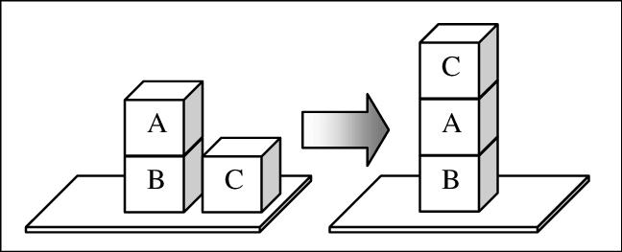
Propositions in Blocksworld
Let’s consider the propositions in a given state of BlocksWorld.
s(A-on-B) = T
s(A-on-C) = F
s(A-on-table) = F
s(B-on-A) = F
s(B-on-C) = F
s(B-on-table) = T
s(C-on-A) = F
s(C-on-B) = F
s(C-on-table) = T
s(A-clear) = T
s(B-clear) = F
s(C-clear) = T
Notes:
So let’s consider what would happen if we were to enumerate all propositions for even something as simple as Blocksworld.
So here we have five propositions that are true:
A is on B
B is on the table
C is on the table
A is clear
C is clear
But look at how many other facts we’re encapsulating here. There are seven more propositions that are false, bringing it to a total of 12.
With this in mind, how many unique possible combinations is there?

Slide 5
Propositions in Blocksworld
Let’s consider the propositions in a given state of BlocksWorld.
s(A-on-B) = T
s(A-on-C) = F
s(A-on-table) = F
s(B-on-A) = F
s(B-on-C) = F
s(B-on-table) = T
s(C-on-A) = F
s(C-on-B) = F
s(C-on-table) = T
s(A-clear) = T
s(B-clear) = F
s(C-clear) = T
2¹² = 4096 states
(not all reachable)
Notes:
Even a naive calculation of the number of states, 2¹² results in 4096 states.
This is a ridiculous number of possible states, and while not all of these states are reachable, it is evidence of exponential growth in the state space.
Given if were to add another block to the problem…

Slide 6
Propositions in Blocksworld
2²⁰ = 1,048,576 states
(not all reachable)
Let’s consider the propositions in a given state of BlocksWorld.
s(A-on-B) = T
s(A-on-C) = F
s(A-on-table) = F
s(B-on-A) = F
s(B-on-C) = F
s(B-on-table) = T
s(C-on-A) = F
s(C-on-B) = F
s(C-on-table) = T
s(A-clear) = T
s(B-clear) = F
s(C-clear) = T
S(A-on-D) = F
S(B-on-D) = F
S(C-on-D) = F
s(D-on-A) = F
s(D-on-B) = F
s(D-on-C) = F
s(D-on-table) = T
s(D-clear) = T
Notes:
By adding just one new block, the number of propositions increased by a further 8, given we model where D is atop, but also whether the existing blocks are on D and of course if D is clear.
This increases the number of unique combinations from 4096 to 1,048,576.
Now again, I have to stress not all of these are legal or valid combinations and the PDDL actions will ensure we only visit a subset of the total list, but this expresses the point I’m trying to make here.
Ultimately, as problems begin to increase in complexity, the state spaces are exploding in scale accordingly.

Slide 7
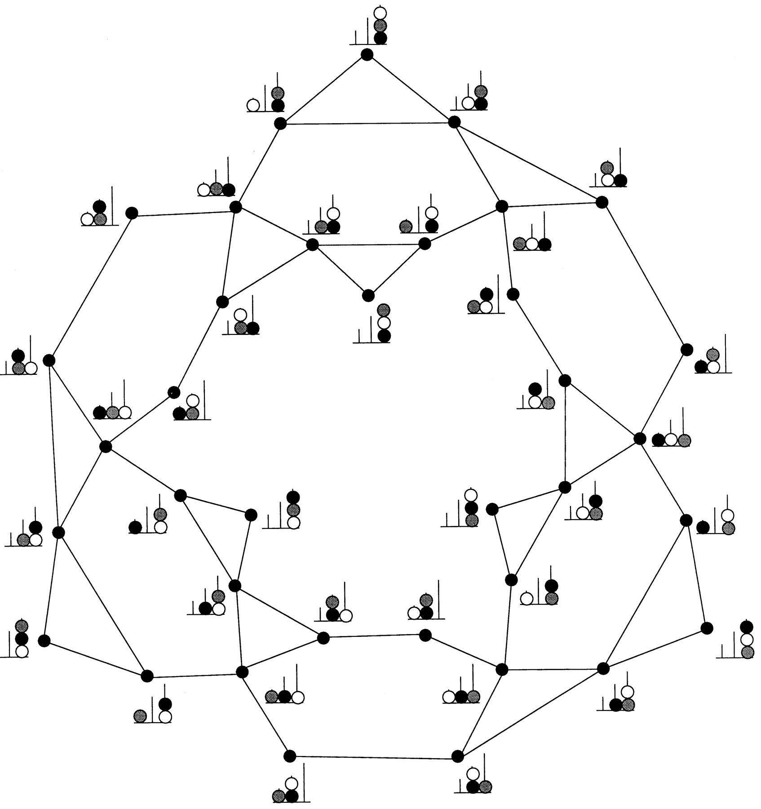
The Perils of Expressivity
Image Credit: A hierarchical neuronal network for planning behavior
Stanislas Dehaene and Jean-Pierre Changeux
PNAS November 25, 1997 94 (24) 13293-13298
By having such an expressive formalism, state spaces can begin to explode.
How do we circumvent this?
Use heuristics to guide the search?
Find landmarks to give us sub-goals to solve?
Use local search (see EHC)?
Often sacrificing completeness of search in an effort to find a solution quickly.
Hence Best-First Search fallback in EHC.
What if we instead sacrifice expressiveness for efficiency?
Notes:
As a result of having all of the possible information that could occur in a problem our state spaces are now increasingly large. One fact transitioning from true to false results in a completely new state. So if we have all of these propositions that could be true in certain situations, then the number of states that encompasses every unique combination of propositions is going to be massive. Even this example shown on the right hand side is but a small taste of how expansive these state spaces can become.
And to-date, what we’ve really looked at is how to find a way to steer our way through this nightmare. Either by using heuristics, which help direct us through the space, or we’ve had landmarks that point out good intermediate goals to try and complete. But as we’ve seen, even that has its problems. Then in the case of both the FF and Identidem planners, we’re using variations of Enforce Hill Climbing – only how they handle local minima or plateau’s is really what is changing, but in each case we’re now being much more aggressively searching the space – often ignoring other opportunities.
Now in each of these cases, we’re sacrificing the completeness of the search: we may use inadmissible heuristics that prevent us from ever visiting a state, landmarks prune areas of the state space given we’re focussed on reaching them – and as we’ve seen this can also cause problems - plus enforced hill climbing is aggressively pushing through the search space to find an answer. And in that, we’re having to rely on Best-First search in the event we reach a dead end.
But in this session, we’re going to consider something different: what if instead of using this original encoding to define our search space, we change the expressivity of the problem to help reduce it.

Slide 8
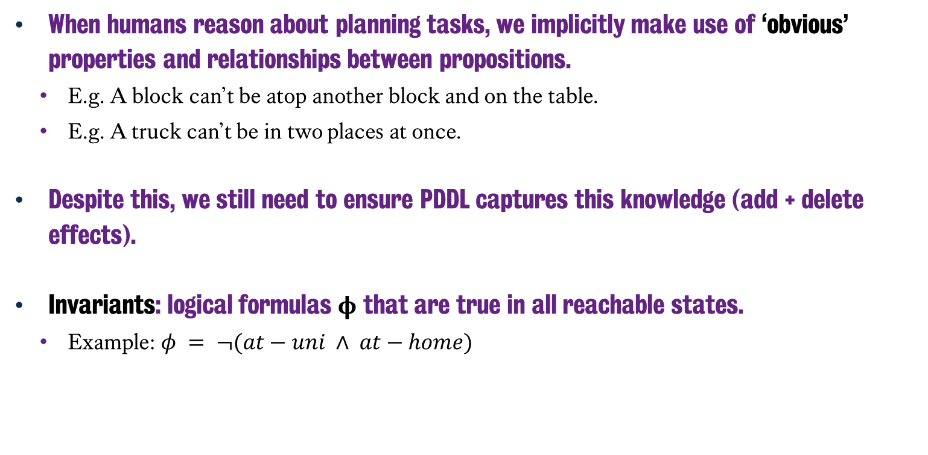
Invariants
When humans reason about planning tasks, we implicitly make use of ‘obvious’ properties and relationships between propositions.
E.g. A block can’t be atop another block and on the table.
E.g. A truck can’t be in two places at once.
Despite this, we still need to ensure PDDL captures this knowledge (add + delete effects).
Invariants: logical formulas ϕ that are true in all reachable states.
Example: $φ = ¬(at−uni ∧ at−home)$
Notes:
So let’s look at it from a different angle and employ a more human tactic. One thing that is immediately obvious to us as humans is that a lot of the propositions relate to one another in certain ways. We generally don’t think about it, because it’s super obvious to us. The simple idea that you can’t be in two places at once, which is critical to our ability to think through some sort of logistics problem, isn’t something that is going to be obvious to the planner.
Hence for example, when we create an action in PDDL that moves an object from one place to another, we have to use the add and delete effects to express this very succinctly. That if we are say moving A to B, now that I am at B, I am most certainly no longer at A. But if I don’t express this in the PDDL, we run risk of creating a new possible state where both of those facts are true. Giving us even more states to explore, but are also incorrect – which is of course how the RPG heuristic is able to solve problems more effectively, because we remove the additional information that we’re no longer at that destination.
So what if we tried to express this ‘obvious’ information in a way that is useful to us in a planner? We can capture this knowledge in what are known as Invariants: a formula that has to be true in any reachable state of the problem. So if we have two locations, say the university and our home and we have two propositions stating we’re at the university or at home, we write an invariant that states there is no way that any valid reachable state of the problem can say that I’m at the university and at home at the same time.

Slide 9
Finding Invariants
Theoretically, testing whether an invariant is valid is as hard as planning itself.
But, if we can find invariants and encode it in a way a planner can understand, we could potentially reduce the state space.
Even finding ‘obvious’ invariants could drastically improve our performance in solving the planning task.
Notes:
Now much like what we saw with finding good heuristics and landmarks, proving whether a function over a set of propositions is in fact an invariant is again a PSPACE-Complete problem.
Why is this? Well again we’re trying to now prove that specific facts do not change in the solving of a problem, which in turn requires us to then try and solve the problem. So once again, we’re hoping we can try and get the answers we need within polynomial time.
But if we can find even the most obvious and simplest of invariants that emerge within a particular problem – and then encode it somehow into the planning system - it could drastically improve the overall performance, given we could prune the state space down to a slightly more manageable size.
So let’s talk about how we could express the state more succinctly…

Slide 10
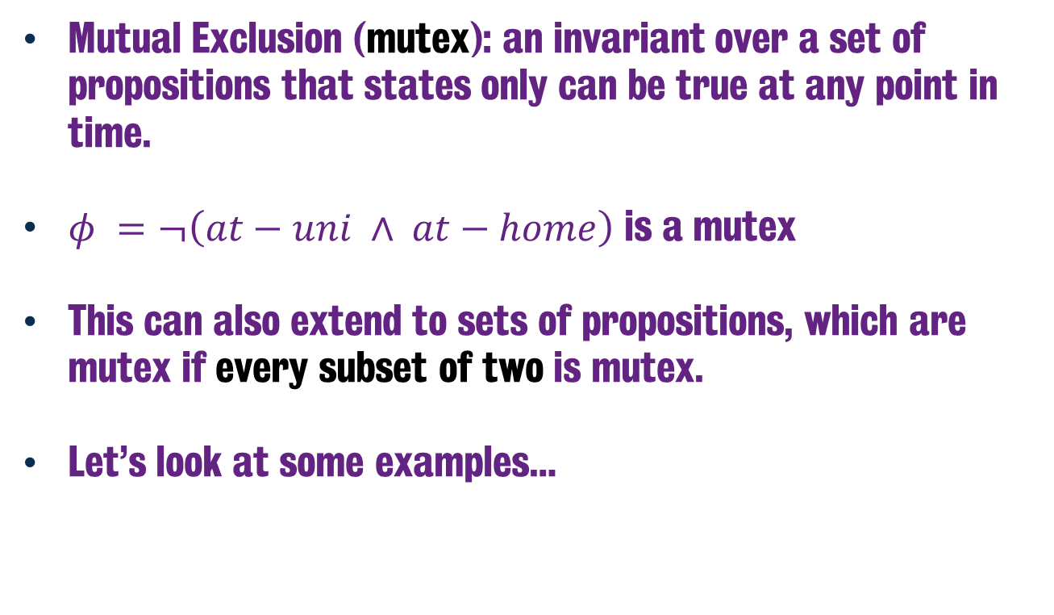
Mutual Exclusion
Mutual Exclusion (mutex): an invariant over a set of propositions that states only can be true at any point in time.
$φ =¬\left(at−uni ∧ at−home\right)$ is a mutex
This can also extend to sets of propositions, which are mutex if every subset of two is mutex.
Let’s look at some examples…
Notes:
One of the most commonly used invariants that we will see today but also in later sessions in this module is a mutual exclusion or mutex relationship.
This is an invariant over a set of propositions where only proposition can be true at any given point of time. Hence if we return to my example from earlier, being at the university and being at home is a mutex. Because only one of those two propositions will be true in any given state.
Now this can extend out to sets of literals, and we can express that any subset is also going to be mutex.
To help give this some clarification, let’s take a closer look at the blocksworld example again and how we could go about expressing that through mutexes.

Slide 11
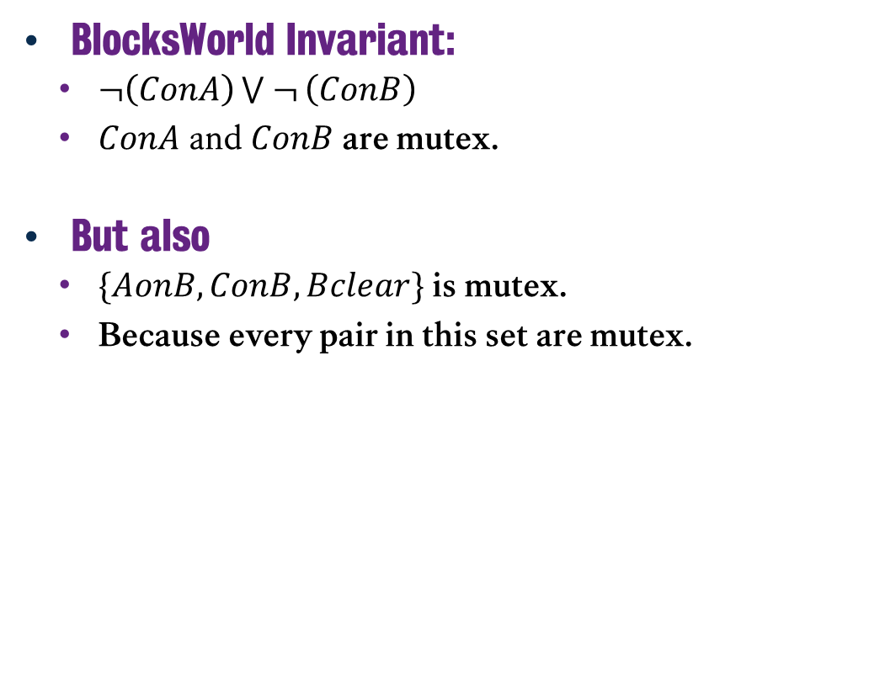
Mutual Exclusive: Example
BlocksWorld Invariant:
$¬\left(ConA\right)\bigvee{ ¬}\left(ConB\right)$
$ConA$ and $ConB$ are mutex.
But also
$\{AonB, ConB, Bclear\}$is mutex.
Because every pair in this set are mutex.
Notes:
A simple example is an invariant that states block C is not on block A or is not on block B, meaning that C-on-A and C-on-B cannot hold true at the same time.
This mutex sufficiently describes the phenomena that C cannot be on two different blocks at the same time, but it doesn’t express that C can also be on the table, but we can use mutexes arranged from sets of literals to help us encapsulate these broader relationships.
So, if we consider a set of literals, A-on-B, C-on-B and B-clear. This set is also mutually exclusive. Why? Because every possible pairing in this set is also mutex.

Slide 12
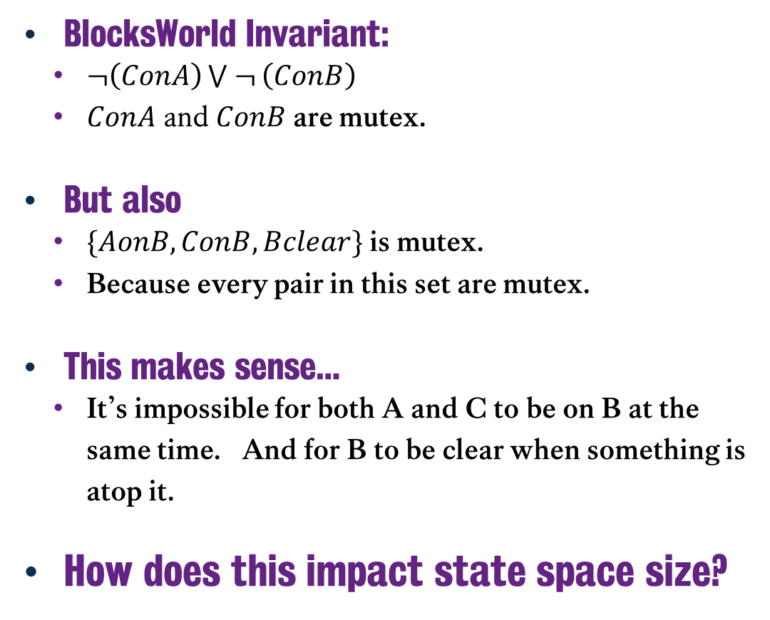
Mutual Exclusive: Example
BlocksWorld Invariant:
$¬\left(ConA\right)\bigvee{ ¬}\left(ConB\right)$
$ConA$ and $ConB$ are mutex.
But also
$\{AonB, ConB, Bclear\}$is mutex.
Because every pair in this set are mutex.
This makes sense…
It’s impossible for both A and C to be on B at the same time. And for B to be clear when something is atop it.
How does this impact state space size?
{AonB, ConB}
{AonB, Bclear}
{ConB, Bclear}
Notes:
If we enumerate all of the unique subsets, we have three combinations:
A is on B and C is on B
A is on B and B is clear
C is on B and B is clear.
In each case, the pair of propositions is also mutex. It’s impossible for C to be on B and A to be on B at the same time.
Plus if either A or C are on B, it’s impossible for B to be clear, because, y’know, there’s something sitting on top of it.
So, if we were to consider these mutex relationships, how does we begin to encode this in a more succinct way?

Slide 13
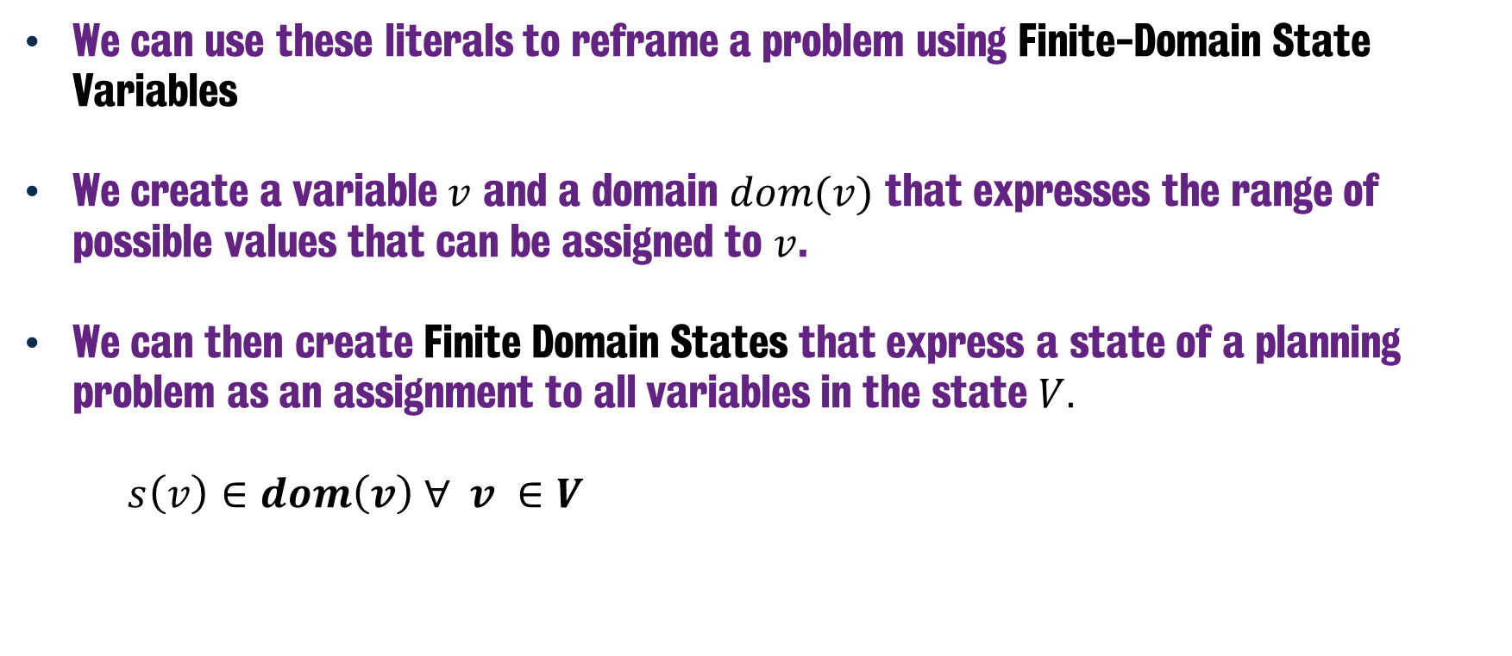
Finite-Domain State Variables
We can use these literals to reframe a problem using Finite-Domain State Variables
We create a variable $v$ and a domain $dom(v)$ that expresses the range of possible values that can be assigned to $v$.
We can then create Finite Domain States that express a state of a planning problem as an assignment to all variables in the state $V.$
$s\left(v\right)∈dom\left(v\right) ∀ v ∈V$
Notes:
So, given we have these relationships, we can begin to encode this information in a different way for a planning problem. This approach, known as finite-domain state variables, sounds quite complicated, but once we see it in an example it will make a lot more sense.
In essence, we are going to create variables that we assign, much like before, but this time we express the range of possible values that can be assigned to them. By having this domain, we can reduce the possible assignments and keep the overall state space much tighter.
Ultimately, one state is then an assign of all variables in the state to a value within their respective domains.

Slide 14
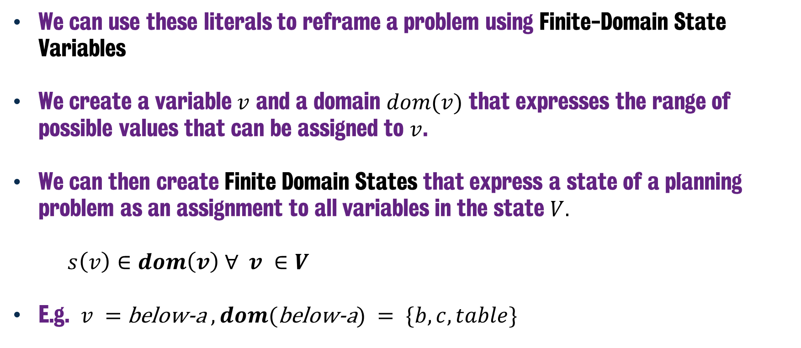
Finite-Domain State Variables
We can use these literals to reframe a problem using Finite-Domain State Variables
We create a variable $v$ and a domain $dom(v)$ that expresses the range of possible values that can be assigned to $v$.
We can then create Finite Domain States that express a state of a planning problem as an assignment to all variables in the state $V.$
$s\left(v\right)∈dom\left(v\right) ∀ v ∈V$
E.g. $v =$ below-a$, dom($below-a$) = \{b, c, table\}$
Notes:
A simple example of this would be to have a variable that encapsulates what block is underneath block A.
The domain for this variable, would then be either the block B or C, or nothing, there’s no block underneath it.
This encoding allows us to say either B-on-A, C-on-A or A-on-table, but instead of three different propositions that we need to ensure don’t contradict one another, we now have one variable that expresses all of this information really succinctly and prevents the mutex situations from occurring.

Slide 15
Blocksworld using Finite-Domain Representation
Let’s revisit BlocksWorld, but this time using propositions and Finite-Domain State Variables.
below-a: {b, c, table} = b below-b: {a, c, table} = table
below-c: {a, b, table} = table
Notes:
So what if we were to try and encode the same BlocksWorld encoding, but this time, we can encapsulate the information in a different way.
Let’s try and use these finite domain state variabls, which express what block can be underneath another block. Now there are some issues here, given that we do not successfully encapsulate whether the blocks are clear to put anything atop them, but let’s just consider for a moment how big this state space is.

Slide 16
Blocksworld using Finite-Domain Representation
Let’s revisit BlocksWorld, but this time using Finite-Domain State Variables.
below-a: {b, c, table} = b below-b: {a, c, table} = table
below-c: {a, b, table} = table
3³ = 27 states
Notes:
If we return to our naïve calculations from before, there are only 27 possible combinations here. This already a massive improvement. We’re removing so much complexity from the state space by capturing all of the critical information about the problem in a way that is much more computationally tractable to explore.
But as I mentioned, this isn’t complete: given this does not successfully encapsulate whether a block is clear or not. Now, we could infer this by checking each relation to see if for a given block X, the variable assigned in one of these relations is X. That would tell us it is beneath something else. But still, this doesn’t help accurately model the state, so let’s try adding a different formalism to the problem that will capture this information.

Slide 17
Blocksworld using Finite-Domain Representation
Let’s revisit BlocksWorld, but this time using Finite-Domain State Variables.
below-a: {b, c, table} = b below-b: {a, c, table} = table
below-c: {a, b, table} = table
above-a: {b, c, nothing} = nothing above-b: {a, c, nothing} = a
above-c: {a, b, nothing} = nothing
6³ = 216 states
Notes:
If we establish a different encoding, where we also model all of the blocks that are above A, B and C, we have successfully encapsulated all the information about the state that we needed.
So in this case, above-a, encodes the mutex of {B-on-A, C-on-A and A-clear).
And as a result, while we have increased the total number of unique configurations from 27 to 216, this is significantly less than the original 4096 states we calculated earlier.
But also, it is worth mentioning that there are relationships that exist between the below and above variables here as well. Given for example, below-a and above-a shouldn’t have the same value. Given that would mean that a block is in two different places at the same time which is of course an invalid state. But also, if below-a is assigned to B, then above-b should be assigned to a.
So even having reduced this state space to this level, there are further constraints that could be applied to this problem space.
But for now, this is a good start. We have successfully encapsulated a lot of obvious information

Slide 18
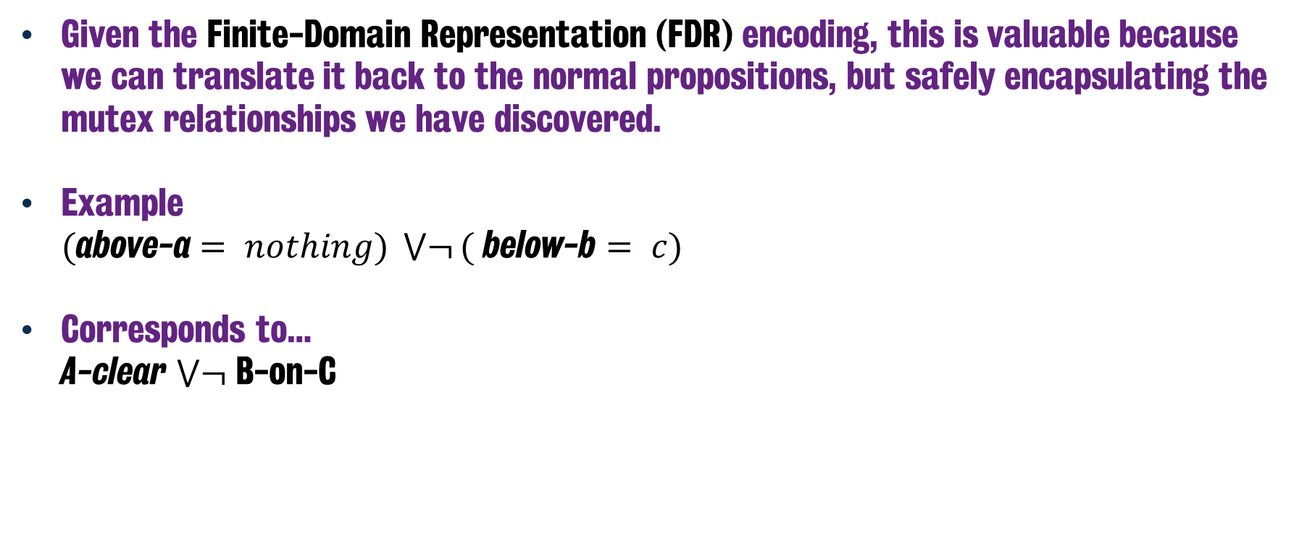
Finite-Domain Formula
Given the Finite-Domain Representation (FDR) encoding, this is valuable because we can translate it back to the normal propositions, but safely encapsulating the mutex relationships we have discovered.
Example $($above-a$= nothing) \bigvee{¬}($ below-b $= c)$
Corresponds to… A-clear $\bigvee{¬}$ B-on-C
Notes:
And what makes this useful, is that we can we can effectively translate any Finite-Domain State back into the propositions mentioned earlier.
We can create Finite Domain Formulae, whereby we can now express rules or constraints we wish to have over a given problem space, but do so in a way that can later be reduced to their atomic propositions that we saw earlier.
For anyone who has previously studied our Introduction to Artificial Intelligence class, you’ll perhaps have noted that a lot of this shares similarities with constraint satisfaction problems or CSPs, whereby we impose rules and constraints on the variables involved in a given problem and how they relate to one another. As mentioned back in that class, you can with some effort encode planning problems as CSPs and indeed vice versa, but here we’re aiming to reframe an existing planning problem using many of the core principles, so that it speeds up the planning search.
Now, having discussed this at length, how can you actually use this in a planner?

Slide 19
Planning as Satisfiability (SAS+)
Adopt the intuition from finite-state variables into our planning process.
To do this, we need to encode the planning task as a Boolean Satisfiability problem (SAT), through use of the propositions we’ve seen earlier.
We then introduce the FDR encodings transforming the SAT problem into a SAS+ Planning problem.
This process was popularised by the Fast Downward Planner, which translates PDDL problem encodings into FDR.
Helmert, M., 2006. The fast downward planning system.
Journal of Artificial Intelligence Research, 26, pp.191-246.
Notes:
So we can adopt the principles of a finite domain representation (FDR) into planning.
If we consider how at the beginning of this chapter, we modelled our planning problem as a list or propositions that are true or false, this is in essence us re-encoding a planning problem as a Boolean Satisfiability of SAT problem.
You can go one step further and translate the PDDL into instead into the finite-domain representation encoding, capturing these mutex relations. In essence allowing us to then solve this constrained-enforced variation.
This process is an avenue of planning research and was popularised by Malte Helmert’s Fast Downward planner, which goes through the process of translating a PDDL problem into the FDR encoding.

Slide 20
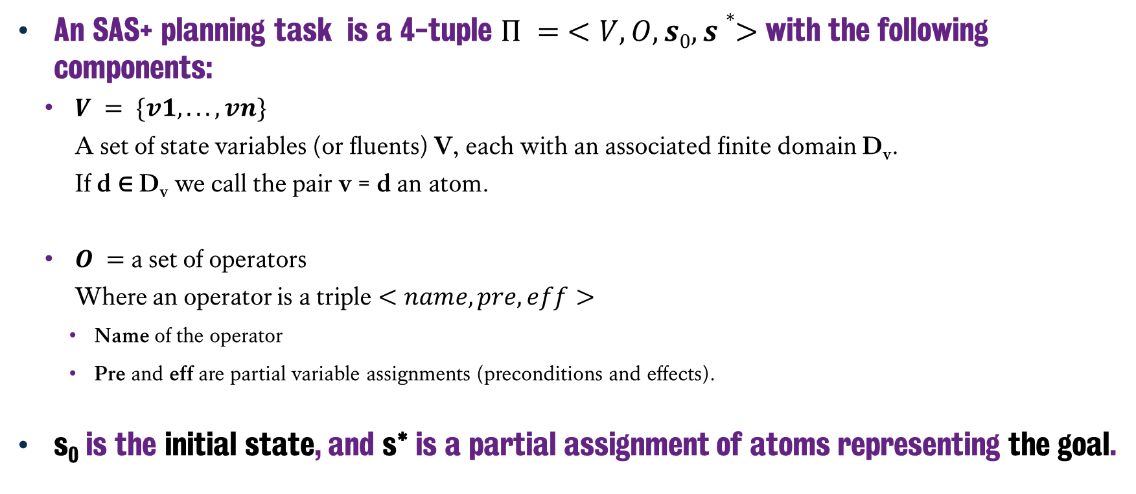
SAS+ More Formally
An SAS+ planning task is a 4-tuple $Π = <V, O, s0, s∗>$with the following components:
$V = \{v1, . . . , vn\}$ A set of state variables (or fluents) V, each with an associated finite domain D_{v}. If d ∈ D_{v} we call the pair v = d an atom.
$O =$a set of operators Where an operator is a triple $<name, pre, eff>$
Name of the operator
Pre and eff are partial variable assignments (preconditions and effects).
s₀ is the initial state, and s* is a partial assignment of atoms representing the goal.
Notes:
Perhaps a little more formally, we can express our SAS+ planning problem as a 4-tuple of comprised of…
The set of all state variables V (which can also be fluent or numeric values), each with their own associated domain of possible values.
Any assignment of those variables to a value in their domain is known as an atom.
The set of all operators, effectively replacing the actions.
This includes the name of the operator, and the partial variable assignments covering the preconditions and effects.
S₀ which is the initial state and S* which is the goal state. In the goal state definition and the preconditions and effects, we provide partial variable assignments. Given we are only interested in a given action in changing specific variables in the current collection of assignments V. While also in the goal we’re only interested in whether certain conditions are true, much like before in PDDL where we’re not listing the entire state that we expect to happen.

Slide 21
Operators (Actions)
Actions look a little different under SAS+:
Two sorts of conditions roll PDDL preconditions and effects together.
prevail conditions:
Variable = Value that stays the same;
When loading a package p1 onto a truck t1 at location l1: <t1,at-l1>
pre_post conditions:
The value of a variable changes from one value to another:
When loading a package p1 onto a truck t1 at location l1: <p1,at-l1,in-t1>
Notes:
Now that we have our operators, there are two unique types of conditions that influence how an action rolls out. These emerge from the ability to recognise how variable assignments change (or don’t) during an action.
- There are prevail conditions, which dictate that during the execution of an action, this variable’s value does not change. So for example, if we’re trying to load a package onto a truck at a given location, the location of the truck isn’t going to change during the execution of the action. This reinforcing constraints of the PDDL notation, but also imposing a rule that says that these values cannot be changed during search.
And then there are the pre-post conditions, where the value of the variable will change from one value to another. Hence if we revisit that loading package action, the package itself is going to move from being at location 1 to being in truck 1. And of course these are legal assignments, given the values of at-l1 and in-t1 are part of the domain of values that are permitted for package p1 to be assigned.

Slide 22
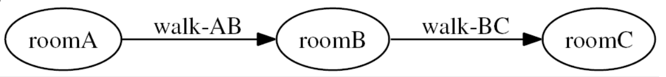
Domain Transition Graphs (DTGs)
Domain: One for each variable, referring to its domain;
Transition: pre_post conditions of operators change the values of a variable;
Graph: Transitions in the domain form a directed graph.
Nodes:
The domain values.
Edges:
An edge exists from A→B iff an operator exists with a pre_post condition < v,A,B>
Notes:
One nice way to visualise this process is through use of Domain Transition Graphs or DTGs. Whereby we are watching how specific pre-post conditions of an operator transform the assignment of a variable.
Each node of a DTG is the values that exist for a given variable, with edges on the graph being the SAS+ operator that successfully transitions the assignment of that variable.
It’s a really simple but powerful way to visualise how variables will change within this new encoding.

Slide 23
Interesting DTGs
Inter-continental logistics: a truck which can drive itself (on land) or use a ferry.
Actions: Drive the truck
PDDL action: drive ?truck ?a ?b ;
Analysis will detect truck can only be in once place at once.
Action: Load the truck onto the ferry
PDDL action: board-ferry ?truck ?ferry ?p
Deletes (at ?truck ?p) but gives (on ?ferry ?truck).
Similarly: disembark from ferry.
In both of these cases: we are deleting one thing to give another, so being on ferry is mutually exclusive with being at a location.
Notes:
So let’s look at an interesting example of this found in inter-continental logistics: a domain where a truck can drive around on land but also use a ferry to move between locations where plausible.
We have three actions that can manipulate information about the truck.
First or all we have a drive action, that moves a truck from A to B.
We have the ability for the truck to board a ferry.
And of course the ability to disembark the ferry as well.
Now by encoding this as a SAS+ planning problem, we can observe numerous constraints on the problem. First of all that the truck can only be in once place at once, which will be inferred from the action to drive the truck.
But also that getting on and off the ferry influences where the truck is as well. As such, entire problem can be reduced to one variable: where the truck is and the domain captures all possible locations.

Slide 24
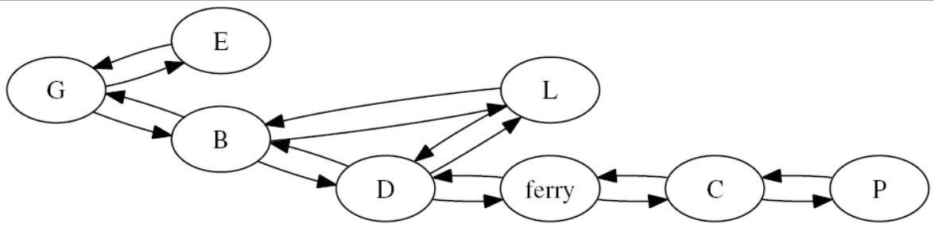
Interesting DTGs
Result in SAS+: is a single variable for the truck's status corresponding to both at and on in the original PDDL.
Notes:
So here is a DTG that encapsulates the entire problem.
It’s just one variable, where is the truck? And the edges of the graph are drive or load/unload actions that change that value.
Given you’ll notice there are specific locations, which are the letters and then of course there is the ferry, which is clearly noted here.
Of course the ferry can only be achieved if that is a valid action when the variable is assigned to either D or C.
But in essence, we can see that this entire planning problem is one variable which has 8 possible values:
B, C, D, E, G, L, P or Ferry.
Now, you might’ve figured this out already, but what this actually a real world problem…

Slide 25
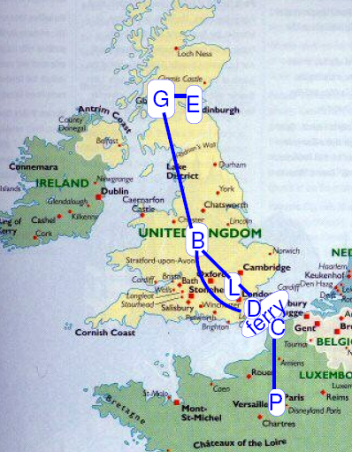
Interesting DTGs
Shuffle the nodes around and we get…
Notes:
If we superimpose that DTG over a map, we have a logistics problem where the truck is driving between Glasgow, Edinburgh, Birmingham, London and Dover in the UK and between Calais and Paris in France. With the ferry between Dover and Calais being the means to move across.
So with SAS+ planning we’re able to successfully encapsulate all of the constraints of the logistics problem – including the road network and vehicle limitations – by first storing this information in PDDL, then applying the finite-domain representation to reduce it to a SAS+ planning problem, which in turn will make it much easier to solve.

Slide 26
Summary
There are other ways to model planning SAS+ is one of them.
This doesn’t magically solve planning for us, given it can only be used in very specific contexts (conditional effects are not possible).
But it shows we can optimise planning by approaching the problem in different ways.
Notes:
So to wrap up, SAS+ is a good example of showcasing that planning doesn’t always need to be formulated in the way that we have seen to-date. We can reformulate the problem in different ways, and capture more expressive knowledge of the planning problem as we try to solve it.
SAS+ works well in very specific situations, but it doesn’t magically solve planning, given it isn’t possible to be used in certain situations. Conditional effects for example, whereby we have the possibility that different outcomes can happen with an action. But, it does show us that we can look at these problems from different perspectives.

Slide 27
Classical Planning
Optimal Planning with SAS+
6CCS3AIP – Artificial Intelligence Planning
Dr Tommy Thompson
Notes:
Thanks for watching this chapter on Optimal Planning with SAS+ and we’ll catch you in the next video.

